Slide 1

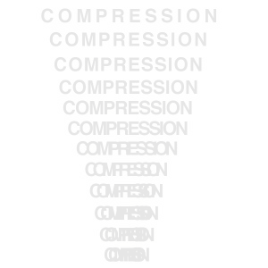

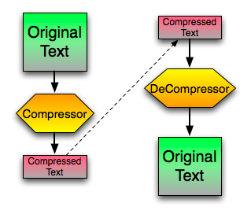
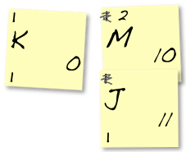
Adaptive-Trainable Compression Algorithm
Roberto Santana Perdomo | r.santana@lab.matcom.uh.cu| Facultad de Matemática y Computación | Universidad de La Habana
Motivations
Possible Aproaches
Putting Everything Together
Currently, most powerfull and
widely used compression
algorithms have been proven
ineffective when compressing bunch of information splited in small pieces is required.
Such cases can be frequently seen in the daily life, such when sending SMS or surfing on Internet.
The inneficient results can be as outstanding as a compression output size of 285% of its original size for a message as common as “Hola, qué tal?” using the DEFLATE algorithm, the adopted standard for HTTP communications.
Static Tables:
Static tables have proven to offer the best predictions rates among all this family of compression approaches. The main drawbacks are the difficulty to synchronize new changes and the high dependency between the nature of the information to compress.
Adaptive Tables:
Adaptive tables have solved all the deficiencies of the above approach at the cost of lower compression rates. They have proven to be the best compression choices for general types of data. The main drawback lies in the fact that they build a table that is specific for the data being compressed, hence, they don’t reuse information from previous compression. For really small pieces of data, the output can be actually bigger than the input.
Rhea Approach:
Rhea is a compression algorithm partially ported to .NET from FemtoZip by Ayende Rahien in 2014.
This approach builds an adaptive table that persist between different “training sessions” achieving, as a consequence, the best from adaptive algorithms without the “Alzheimer” problem.
Its main drawback is that, in order to improve efficiency, it only tries to detect frequent words, resulting in a good approach only for very small pieces of information, like SMSs.
Frequent Pattern Miner:
C# implementation created by Del Tongo Luca & Gianluca Ghettini that uses an Apriori approach for the detection of frequent pattern on data bases.
Grammar Analysis:
Several types of data belongs to well-studied grammar groups, like the programming languages sources files. By analyzing the structure of a given file, one can actually split the file into several scopes, allowing the use of better statistic tables and achieving better compression rates.
By using FPM we can increase the word size of a Rhea-like approach creating an algorithm that can be trained over thousands of members in the same set of data to compress in order to detect the biggest patterns.
Then, we can remove the need of training
and, following an initial training, adapt the
built table after every compression,
adapting at the same time, to minor
changes in the nature of the information.
By using this adaptive approach, there will be no synchronization problems between compressor and decompressor.
Ultimately, applying a grammar analysis will
allow us to separate the different syntactic pieces
of a file resulting in a reduction of the scope and into a reduction of the table and the encoding size.
As our feasibility tests show, html data, for example, can be compressed even to less than 9%, a rate that was impossible to figure out just a few years ago.
Research Goals
Develop an algorithm that can actually compress this kind of information.
The algorithm should be isolated from the nature of the information to compress, so that it can be acceptably efficient under any given scope.
The algorithm should be efficient enough to allow its use in low performing devices, such as phones and tablets.
Further Steps
A direct application of FPM has a hig cost in time and space complexity. Even performing just an initial training may require a lot of time for the amount of subjects that need to be checked. Also, increasing the number of scenarios, a direct consequence of reducing the scope, dramatically increases the space required to store the tables.
If any of the compression or decompression algorithms will be executed in low potency devices then they should be tailored to consume few resources.
Synchronizing the table shouldn’t be expensive at all.
Feasibility Checks
References & Aknowledges
Timothy C. Bell, John G. Cleary, Ian H. Witten-Text compression -Prentice Hall (1990)
@ Del Tongo Luca, Gianluca Ghettini, Frequent Pattern Mining.
2014, Ayende Rahien, Rhea Compression
Wikipedia, the free encyclopedia.
Dmitry Soldiev.

